Slide 1

Eelo University Faculty of Computer sciences Microprocessor and Assembly Language

Slide 2
The Course
Purpose:
The purpose of this course is to introduce computer science majors to computing systems below that of a high-level programming language. The material covered can be broadly separated into the categories of assembly language and computer organization.
Textbook:
Assembly Language Programming, by Neveln.
Microcomputer system the 8086/8088 family architecture, programing and design by Yu-cheng Liu
Introduction to 80x86 Assembly Language and Computer Architecture by Richard C. Detmer

Slide 3
Instructure
Name: Eng. Hassan Jibril Mo’allim(Jabra)
Title: Dean Faculty / senior lecturer computer sciences field for different university /Consultant /Developers
Email Address: ict@eelouversity.org
Office Location: Borama Eelo Main campus
Office hours: Saturday to Thursday time 8:00 to 12:00 p.m.

Slide 4
The Course
Grading policy:
Attendance: 5%
Quiz: 10%
Assignment: 5
Mid exam: 30%
Final: 50%
NB Lab 70% project / 30% class activity

Slide 5
The Course
Format
two lectures/week
One lab /week
Assignments every two weeks

Slide 6
Prerequisites
Before you continue you should have a basic understanding of the following:
Digital logic and designing
Computer hardware and troubleshooting
Discrete Math
If you want to study these subjects first, find the library on the flowing Books :
Digital logic and designing
Discrete math
Understanding and troubleshooting your PC

Slide 7
Topics to be Covered:
CHAPTER 1: INTRODUCTION
CHAPTER 2: BASIC COMPUTER ORGANIZATION
CHAPTER 3: OVERVIEW OF INTEL PROCESS AND PENTIUM MICROPROCESSORS, RISC PROCESSORS
CHAPTER 4: OVERVIEW OF ASSEMBLY LANGUAGE INSTRUCTIONS
CHAPTER 5: ADDRESSING MODES
CHAPTER 6: ARITHMETIC FLAGS AND INSTRUCTIONS
CHAPTER 7: SELECTION AND ITERATION
CHAPTER 8: STRING PROCESSING
CHAPTER 9: REAL-MODE INTERRUPTS

Slide 8
Chapter one
Introduction microprocessor and assembly languages

Slide 9
What we cover in this lectures
User’s View of Computer Systems
Microprocessors and Microcomputers
What Is Assembly Language?
Advantages of High-Level Languages
Why Program in the Assembly Language?
Why Learn the Assembly Language?
Summary

Slide 10
A User’s View of Computer Systems
A user’s view of a computer system depends on the degree of abstraction provided by the underlying software.
Figure 1.1 shows a hierarchy of levels at which users can interact with a computer system.
Moving to the top of the hierarchy shields the user from the lower level details.
At the highest level, the user interaction is limited to the interface provided by application software such as a spreadsheet, word processor, and so on.

Slide 11
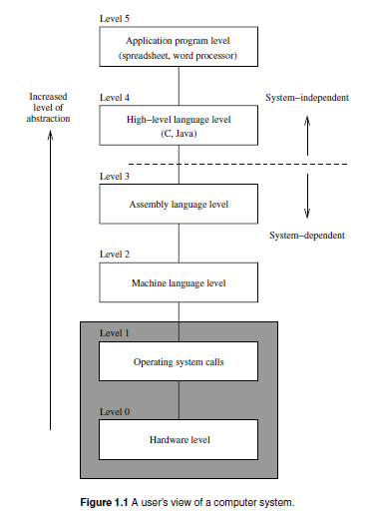
Figure 1.1

Slide 12
Cont.………
The user is expected to have only a rudimentary knowledge of how the system operates.
Problem solving at this level, for example, involves composing a letter using the word processor software.
At the next level, problem solving is done in one of the high-level languages such as C and Java.
A user interacting with the system at this level should have detailed knowledge of software development.

Slide 13
Cont.….
Typically, these users are application programmers.
Level 4 users are knowledgeable about the application and the high-level language that they would use to write the application software.
They may not, however, know internal details of the system unless they also happen to be involved in developing system software such as device drivers, assemblers, linkers, and so on.

Slide 14
Cont..
Both levels 4 and 5 are system-independent, i.e., independent of a particular processor used in the system. For example, an application program written in C can be executed on a system with an Intel processor or a Power PC processor without modifying the source code.
All we have to do is recompile the program with a C compiler native to the target system.
By contrast, software development done at all levels below level 4 is system-dependent.

Slide 15
Cont..
Assembly language programming is referred to as low-level programming because each assembly language instruction performs a much lower-level task compared to an instruction in a high-level language.
As a consequence, to perform the same task, assembly language code tends to be much larger than the equivalent high-level language code.
Assembly language instructions are native to the processor used in the system.
For example, a program written in the Pentium assembly language cannot be executed on the Power PC processor.

Slide 16
Cont..
Programming in the assembly language also requires knowledge about system internal details such as the processor architecture, memory organization, and so on.
Machine language is a close relative of the assembly language. Typically, there is a one to one correspondence between the assembly language and machine language instructions.
The processor understands only the machine language, whose instructions consist of strings of 1’s and 0’s.

Slide 17
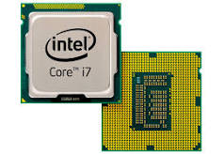
Microprocessor and Microcontroller
A MICROPROCESSOR is a multipurpose programmable logic device that reads binary instructions from a storage device called memory accepts binary data as input and processes data according to those instructions and provides results as input

Slide 18
The microprocessor is the central unit of a computer system that performs arithmetic and logic operations, which generally include adding, subtracting, transferring numbers from one area to another, and comparing two numbers. It's often known simply as a processor, a central processing unit, or as a logic chip.

Slide 19
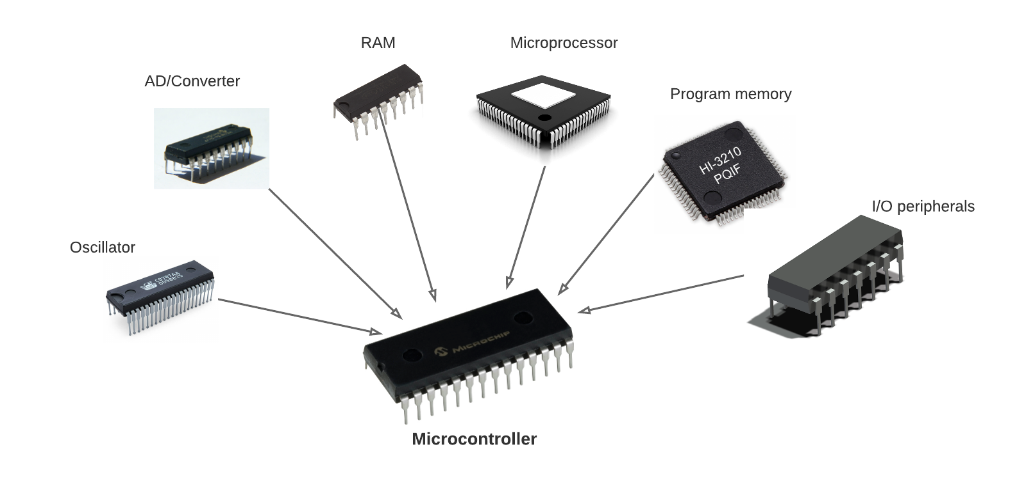
Microcontroller: Is a small computer socket on a single integrated circuit containing a processor core, memory and programmable input and output peripherals.

Slide 20
Microcontroller is a compressed micro computer manufactured to control the functions of embedded systems in office machines, robots, home appliances, motor vehicles, and a number of other gadgets. A microcontroller is comprises components like - memory, peripherals and most importantly a processor.

Slide 21
Microprocessor vs Microcontroller
Microprocessor consists of only a Central Processing Unit, whereas Micro Controller contains a CPU, Memory, I/O all integrated into one chip.
Microprocessor is used in Personal Computers whereas Micro Controller is used in an embedded system.

Slide 22
Microprocessor uses an external bus to interface to RAM, ROM, and other peripherals, on the other hand, Microcontroller uses an internal controlling bus.
Microprocessors are based on Von Neumann model Micro controllers are based on Harvard architecture
Microprocessor is complicated and expensive, with a large number of instructions to process but Microcontroller is inexpensive and straightforward with fewer instructions to process.

Slide 23
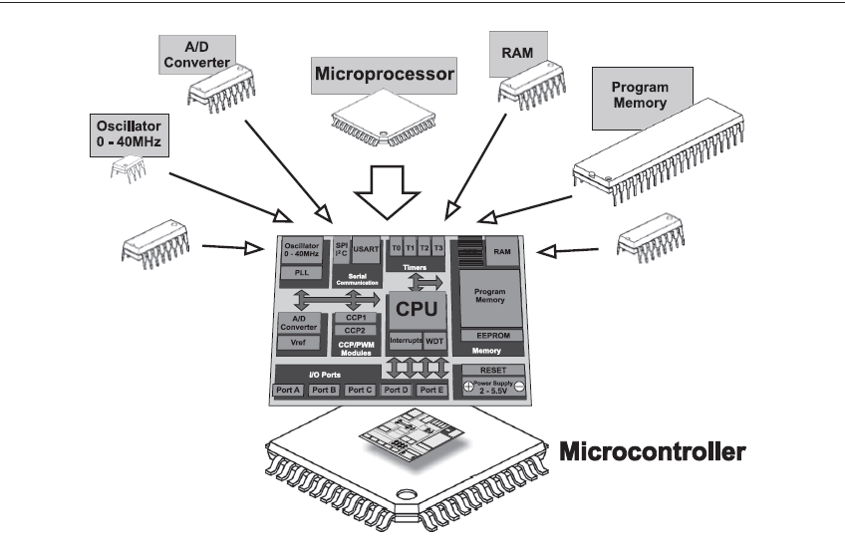
Figure 1.2

Slide 24
Types of Microprocessor
Important types of Microprocessors are:
Complex Instruction Set Microprocessors
The Application Specific Integrated Circuit
Reduced Instruction Set Microprocessors
Digital Signal Multiprocessors (DSPs)

Slide 25
Types of Microcontroller
Here are important types of Microcontroller:
8 bit Microcontroller
16 bit Microcontroller
32 bit Microcontroller
Embedded Microcontroller
External memory Microcontroller

Slide 26
What Is Assembly Language?
Assembly language is directly influenced by the instruction set and architecture of the processor.
There are two basic types of processors: CISC (Complex Instruction Set Computers) and
RISC (Reduced Instruction Set Computers). The Pentium is an example of a CISC processor.

Slide 27
Advantages of High-Level Languages
High-level languages are preferred to program applications, as they provide a convenient abstraction
of the underlying system suitable for problem solving. Here are some advantages of programming in a high-level language:
1. Program development is faster.
Many high-level languages provide structures (sequential, selection, iterative) that facilitate program development. Programs written in a high-level language are relatively small compared to the equivalent programs written in an assembly language.

Slide 28
Cont…..
2. Programs are easier to maintain.
Programming a new application can take from several weeks to several months and the life cycle of such an application software can be several years. There fore, Programs written in a high-level language are easier to understand and, when good programming practices are followed, easier to maintain.
Assembly language programs tend to be lengthy and take more time to code and debug. As a result, they are also difficult to maintain.

Slide 29
Cont…..
3. Programs are portable.
High-level language programs contain very few processor-dependent details. As a result, they can be used with little or no modification on different computer systems. By contrast, assembly language programs are processor-specific.

Slide 30
Why Program in the Assembly Language?
The previous section gives enough reasons to discourage you from programming in the assembly language. However, there are two main reasons why programming is still done in the assembly language: (1) efficiency, and (2) accessibility to system hardware.
Efficiency refers to how “good” a program is in achieving a given objective. Here we consider two objectives based on space (space efficiency) and time (time efficiency).

Slide 31
Typical Applications
We have identified three advantages to programming in an assembly language.
Time efficiency
Accessibility to hardware
Space efficiency
Time efficiency: Applications for which the execution speed is important fall under two categories:
1. Time convenience (to improve performance)
2. Time-critical (to satisfy functionality)
Applications in the first category benefit from time-efficient programs because it is convenient

Slide 32
Why Learn the Assembly Language?
Learning the assembly language has both practical and educational purposes. Even if you don’t mean to program in an assembly language, studying it gives you a good understanding of computer systems. When you program in a high-level language, you are provided only a
“black-box” view of the system. When programming in the assembly language, you need to understand the internal details of the system (for example, you need to know about processor internal registers). To understand the assembly language is to understand the computer system
itself!

Slide 33
Summary
We introduced assembly language and discussed where it fits in the hierarchy of computer languages. Our discussion focused on the usefulness of high-level languages vs the assembly language. We noted that high-level languages are preferred, as their use aids in faster program development, program maintenance, and portability. Assembly language, however, provides two chief benefits: faster program execution, and access to system hardware.
In the last section, we used an example to demonstrate the performance advantage of programming in assembly language.

Slide 34
End of chapter 1
Any questions

